Slide 1
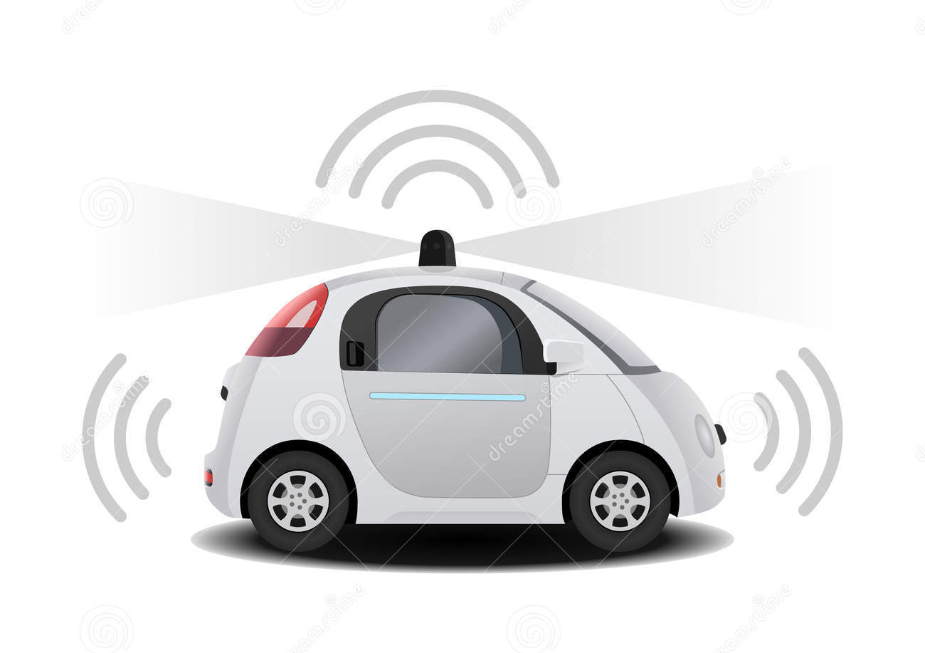

A Learning based Adaptive Cruise and Lane Control System
Peng Xu
Supervisor: Professor Wyatt Newman
Master thesis Defense
Notes:
A Learning based Adaptive Cruise and Lane Control System

Slide 2
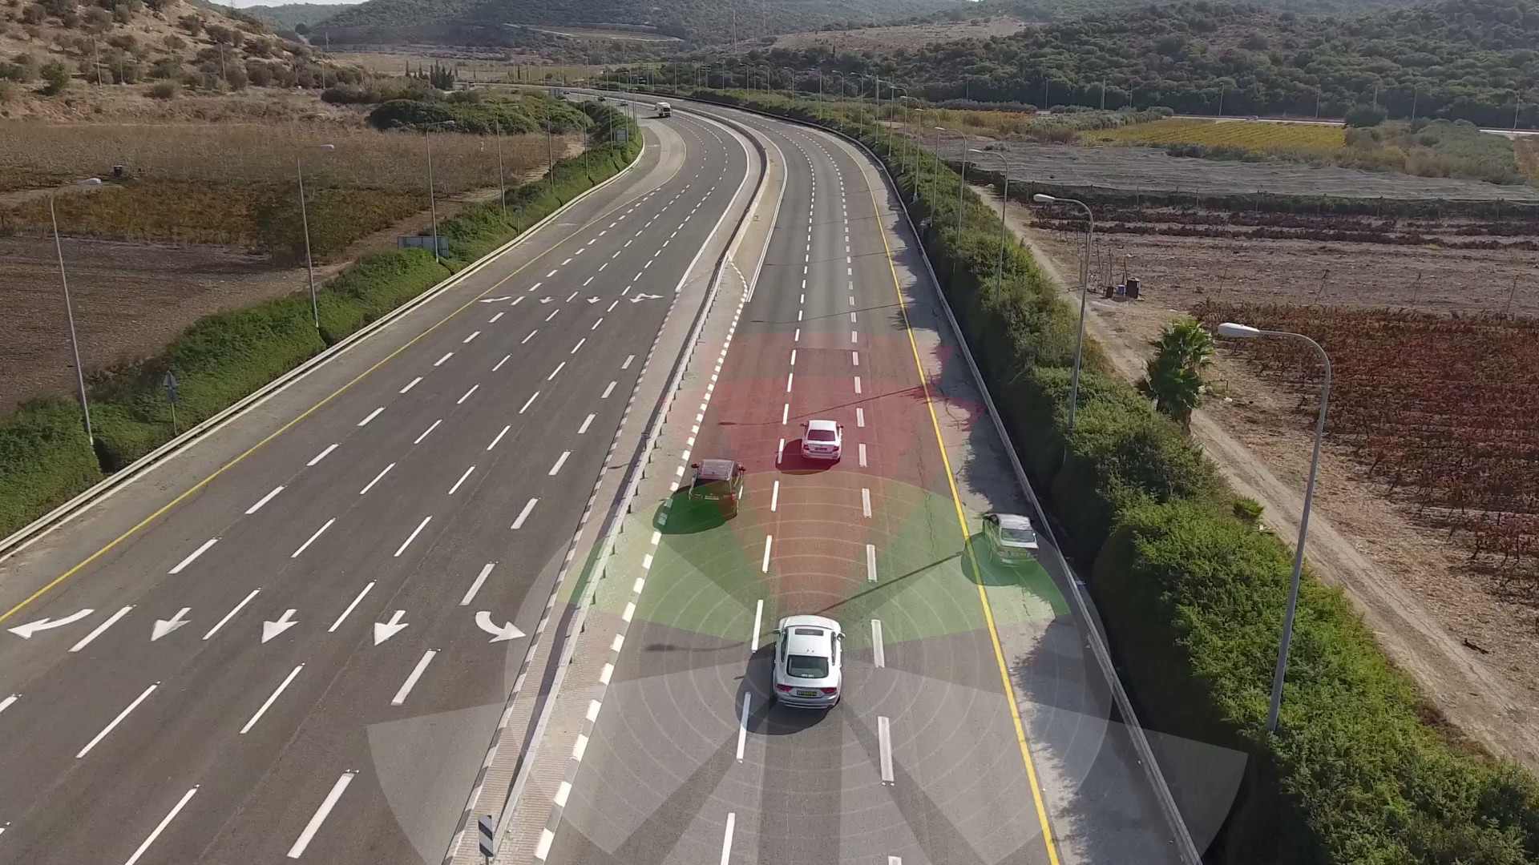
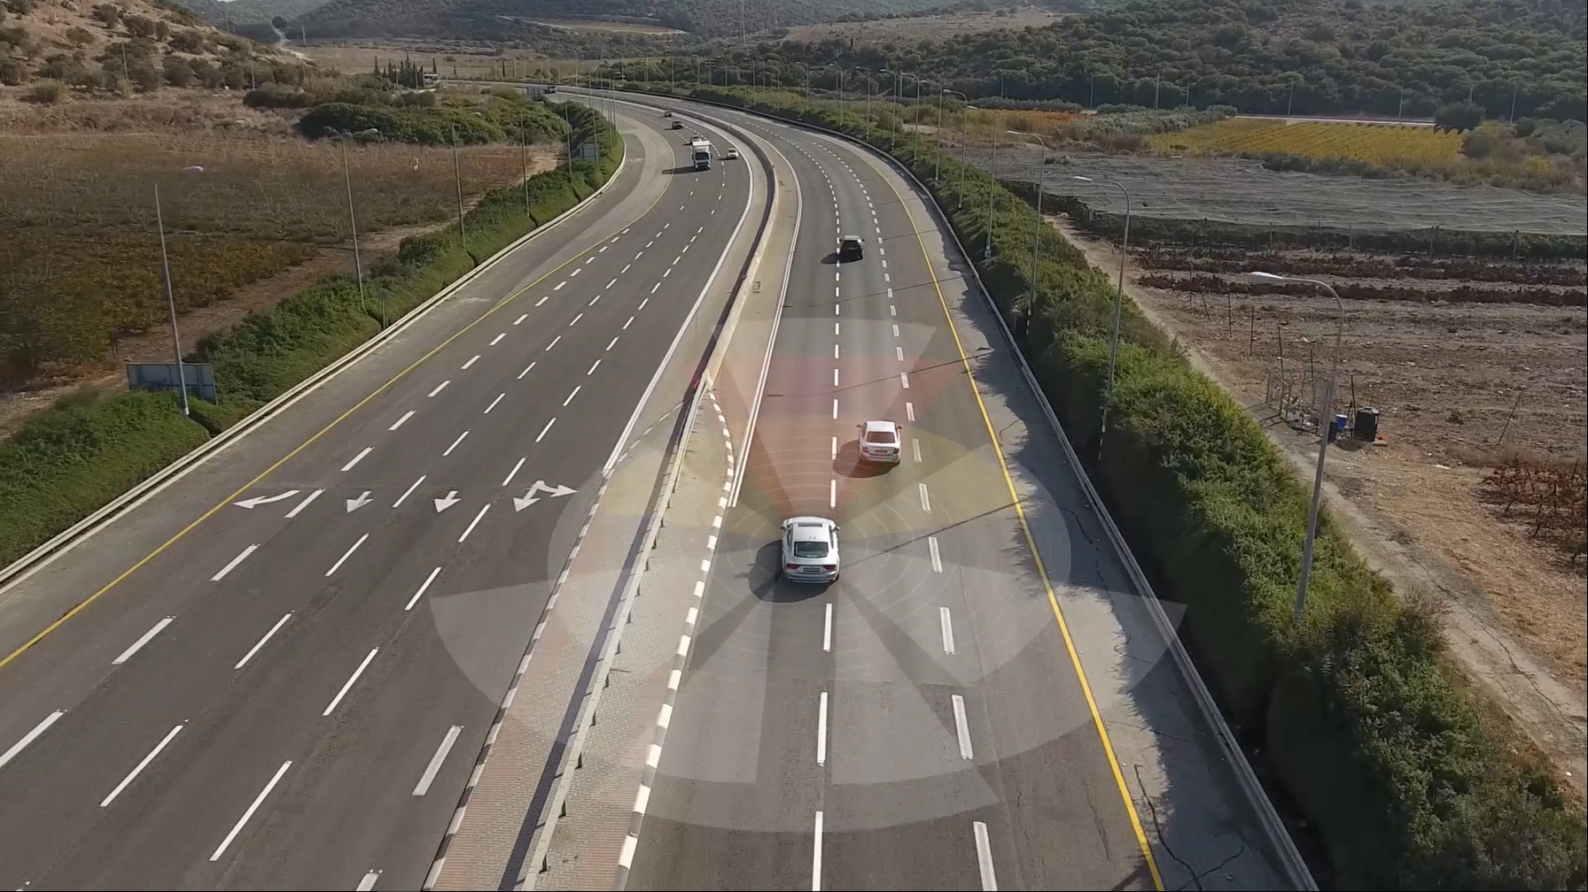
Background
A Learning based Adaptive Cruise and Lane Control System
Adaptive Cruise Control
Lane Control
Notes:
Autonomous highway driving means the autonomous control of the complex driving tasks of highway driving, like driving at a safe speed selected by the driver, changing lanes or overtaking front vehicles depending on the traffic circumstances, automatically reducing speed as necessary or stopping the vehicle in the right most lane in case of an emergency.

Slide 3
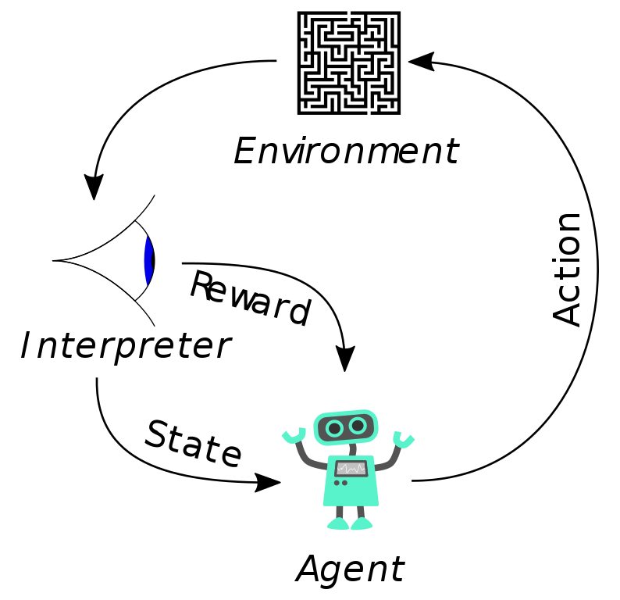
Reinforcement learning
A Learning based Adaptive Cruise and Lane Control System
Reinforcement Learning is a type of machine learning that allows you to create AI agents that learn from the environment by interacting with it. Just like how we learn to ride a bicycle, this kind of AI learns by trial and error.
Model free: Estimating and simulating all of the details of the physical environment is exceedingly difficult. A learning based framework could avoid the detailed and complex modeling associated with the fully model-based approach.
Notes:
As seen in Fig, the robot represents the AI agent, which acts on the environment. After each action, the agent receives the feedback. The feedback consists of the reward and next state of the environment. The reward is usually defined by a human. If we use the analogy of the bicycle, we can define reward as the distance from the original starting point.

Slide 4
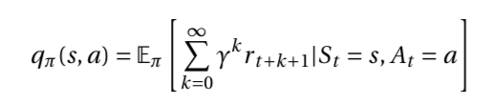
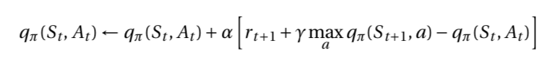
q-Learning
A Learning based Adaptive Cruise and Lane Control System
Q-learning is one of the popular RL methods which searches for the optimal policy in an iterative fashion.
The Q-value function is the expected sum of the future rewards which indicates how good the action a is given the state s under the policy of the agent π. The contribution to the Q-value function decays exponentially with the discounting factor gamma for the rewards with far-off future.
In practice, since it is hard to obtain the exact value of q_{π}(s, a) satisfying the Bellman equation, the Q-learning method uses the following update rule for the given one step backups S_{t} , A_{t} , r_{t+1}, S_{t+1.}
Notes:
The Q-value function is the expected sum of the future rewards which indicates how good the action a is given the state s under the policy of the agent π. The contribution to the Q-value function decays exponentially with the discounting factor π for the rewards with far-off future.

Slide 5
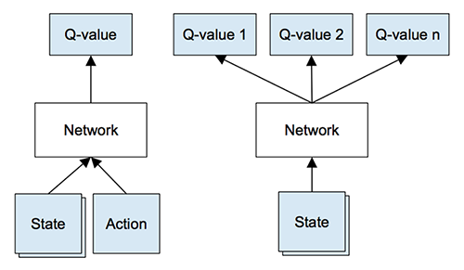
Deep q-Learning (dqn)
A Learning based Adaptive Cruise and Lane Control System
However, when the state space is continuous, it is impossible to find the optimal value of the state-action pair q_{π}(s,a) for all possible states.
To deal with this problem, the DQN method was proposed, which approximates the state-action value function q(s, a) using the DNN.

Slide 6
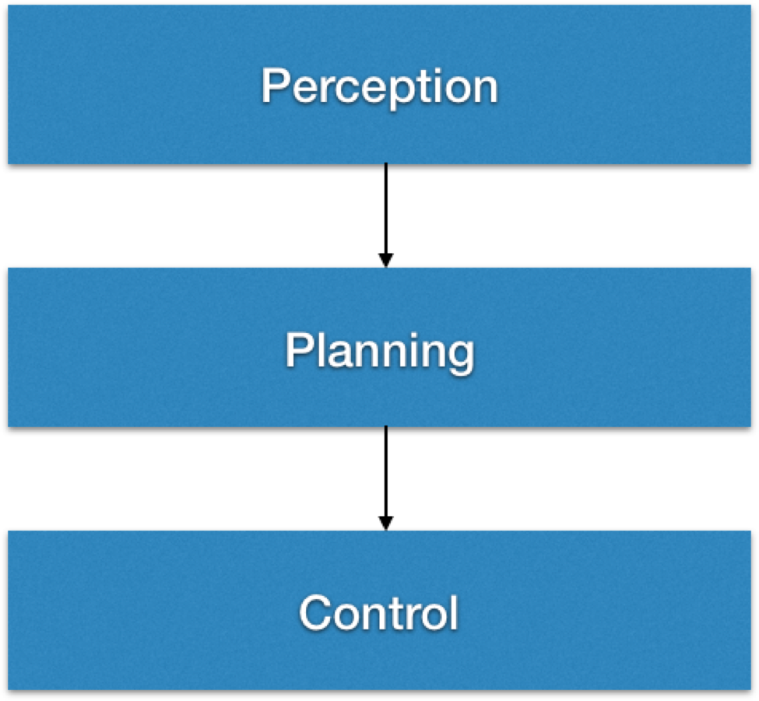
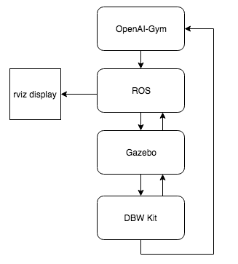
System Design
A Learning based Adaptive Cruise and Lane Control System
Behavior
Path
Notes:
Autonomous System Architecture

Slide 7
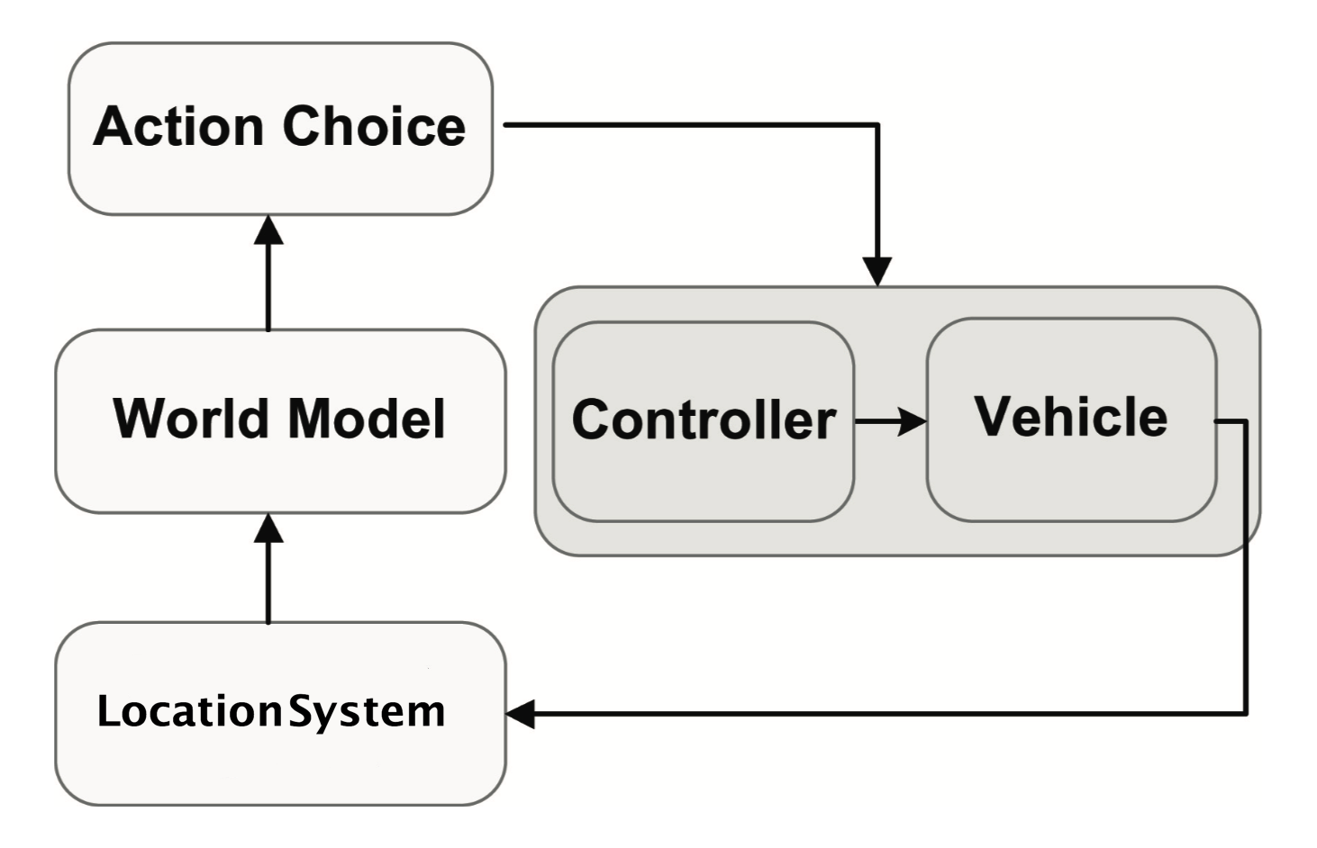
Adaptive Cruise cONTROL SOLUTION
A Learning based Adaptive Cruise and Lane Control System
RL simplifies the design of a longitudinal controller.
The closed-loop controller takes as inputs the vehicle’s state, and selects the appropriate action according to the policy that was learned.
It is possible for the agent to learn the optimal behavior by taking driving actions and observing their results on the time distance and its difference between two time steps.
Notes:
simpler than the complex mathematical analysis needed to pre- dict precise car physics and dynamics for acting, as our controller basically hides in a black box vehicle physics and dynamics.

Slide 8
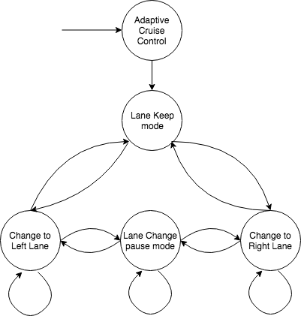
lANE cONTROL sOLUTION
A Learning based Adaptive Cruise and Lane Control System
Lane Control system is using a Finite State Machine (FSM) and hence RL is only responsible for choosing the optimal behavior or next Finite State.
The action space consists of three actions, Change to Left, Keep Lane and Change to Right.
To make such kind of decision, the agent needs to be aware of the nearby vehicle’s position and state in both its current lane and nearby lane.

Slide 9
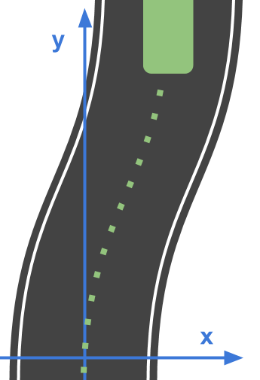
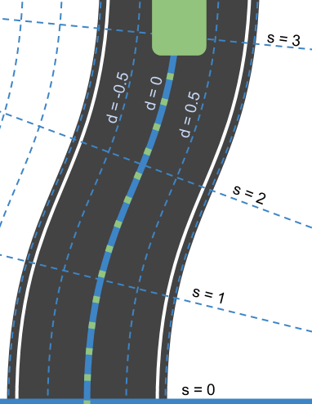
pATH PLANNING: Lane keep & Lane change
A Learning based Adaptive Cruise and Lane Control System
Global route (s)
Lane offset (d)
x, y
Cartesian coordinate
A global coordinate system
Frenet coordinate
A road aligned coordinate system
waypoints
Steering
Notes:
Waypoint following
Lane keep system

Slide 10
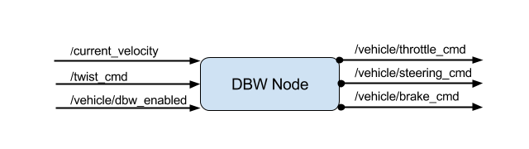
Control
A Learning based Adaptive Cruise and Lane Control System
Drive-by-wire System
Control of throttle, brake and steering
PID control on throttle and brake
Steering torque control
Notes:
ADAS Kit
Our ADAS Kit is a complete hardware and software solution that allows seamless control of throttle, brake, steering, and shifting. It also allows you to control the sensors and computers while accessing data on vehicle networks. Speed up your ADAS development by updating a Lincoln MKZ, Ford Fusion, or Mondeo with the electronics needed for rapid innovation! Dataspeed installs the drive-by-wire hardware, power distribution system, and vehicle network interfaces to get you up and running quickly.

Slide 11
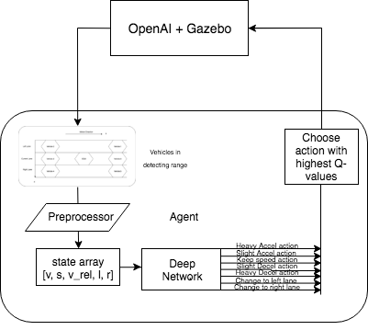
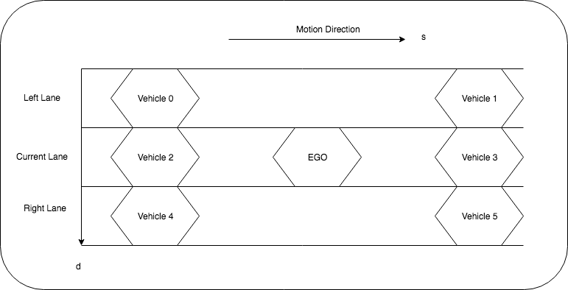
Online Training
A Learning based Adaptive Cruise and Lane Control System
OpenAI and Gazebo are providing online environment state.
Detect vehicles and obstacles within the range.
Preprocess the detected info into the state array.
Feed the state to A Network
Generate scores or q-values for actions.
Choose action based on the update equation.
Notes:
Architecture

Slide 12
Input and output
A Learning based Adaptive Cruise and Lane Control System
State space:
ACC: [v, s_diff, v_diff], n = 3
ACC+LC: [v, s_diff, v_diff, flag_l, flag_r], n = 5
Action space:
ACC: [+2, +1, 0, -1, -2], m = 5
ACC+LC: [+2, +1, 0, -1, -2, ‘Left’, ‘Right’], m = 7

Slide 13
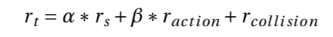
Reward function design
A Learning based Adaptive Cruise and Lane Control System
The first term encourages the vehicle to drive as fast as possible within the speed limit to achieve higher reward.
The second term is to penalize frequent action changes.
The last term indicates the penalty that the agent receives when the accident occurs.
Once the collision happens, a huge penalty is received and the episode ends here.
Notes:
rs is the incremental travel distance along the path of the ego vehicle at the time step t
raction is the reward (or penalty if negative) of the action at the time step t.
The first term α∗rs in the reward function encourages the vehicle to drive as fast as possible within the speed limit to achieve higher reward. It guides the vehicle to drive without deceleration if the preceding vehicle is far from the ego vehicle.
The second term β∗raction is to penalize frequent action changes.
On the other hand, the term rcollision indicates the penalty that the agent receives when the accident occurs. Once the collision happens, a huge penalty is received and the episode ends here. The constants α and β are the weight parameters that controls the trade-off between two objectives.

Slide 14
Results
A Learning based Adaptive Cruise and Lane Control System
ACC Agent: Longitudinal Motion
alpha = 1.0, beta = 4.0
action reward: [+or-2m/s:-1.0, +or-1 m/s: -0.5,: 0.0]
collision: -100
Fully Connected Network:[input: 3, 100, 70, 50, 70, 100, output: 5]
ACC & LC Agent: Longitudinal and Lateral Motion
alpha = 1.0, beta = 2.0
action reward: [+or-2m/s:-1.0, +or-1 m/s: -0.5,: 0.0, left or right: -1, left or right when not available: -3.5]
collision: -100
Fully Connected Network: [input: 5, 100, 70, 50, 70, 100, output: 7]

Slide 15
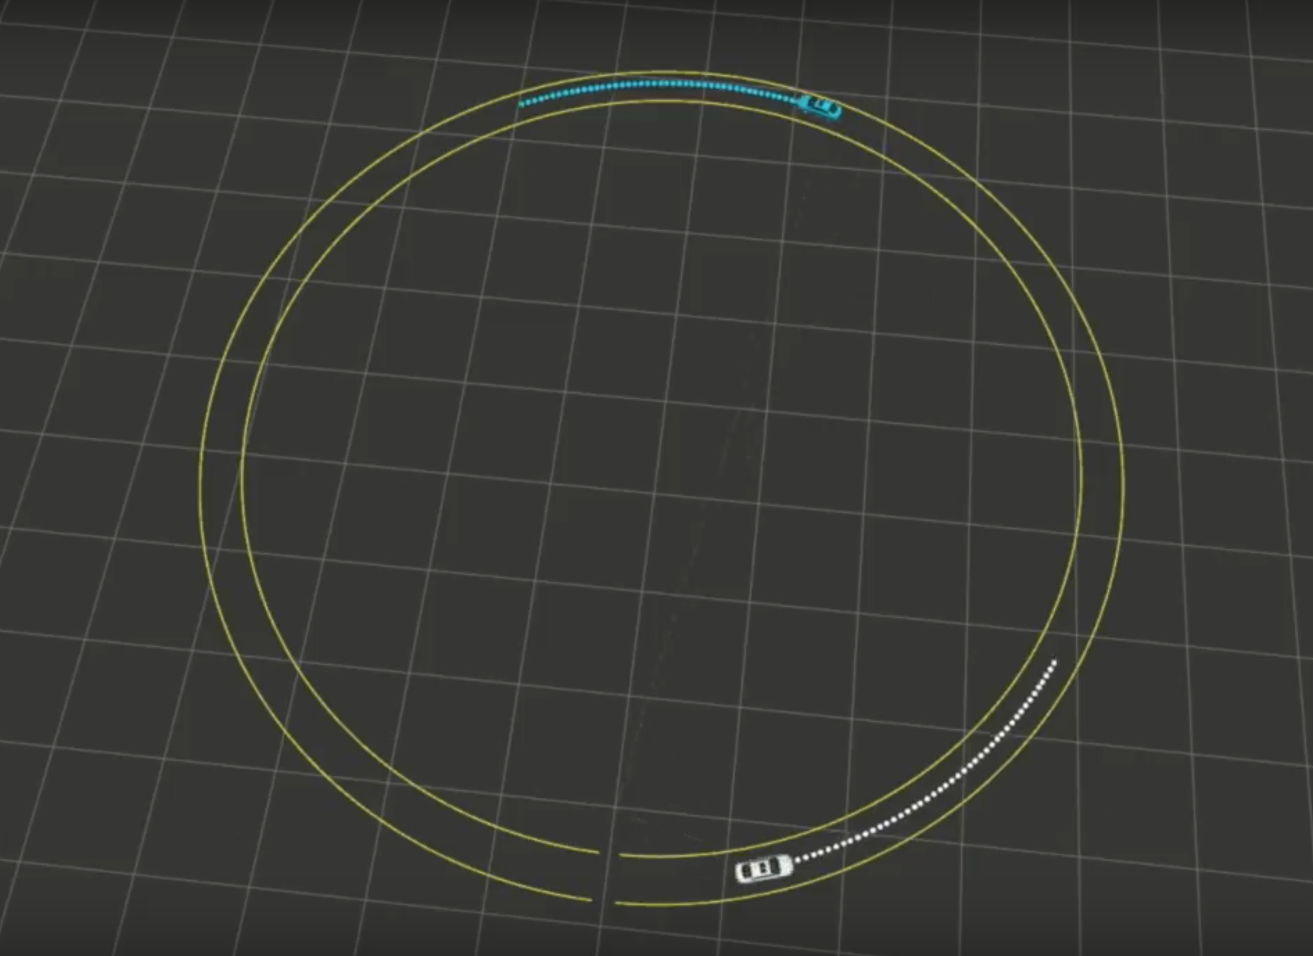
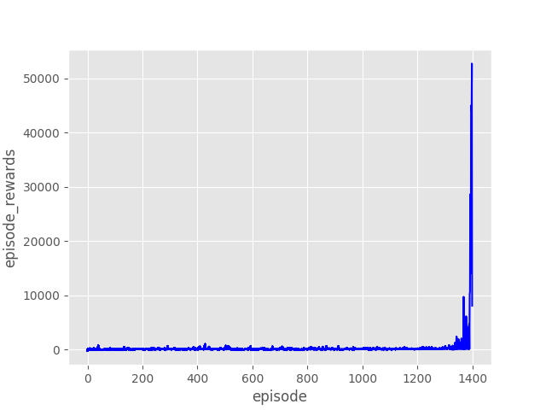
Train an ACC agent
A Learning based Adaptive Cruise and Lane Control System
A sing-lane highway environment
Reward history

Slide 16
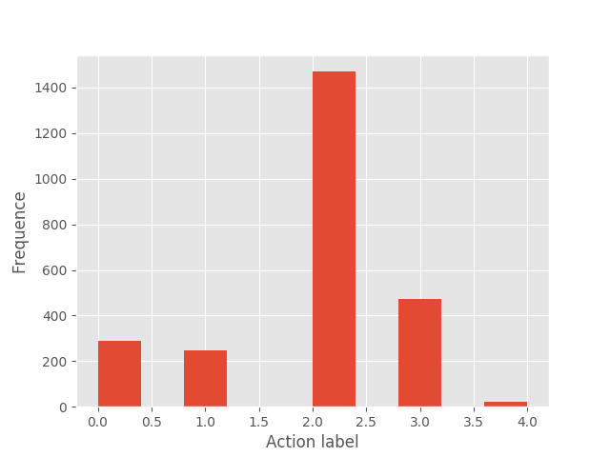
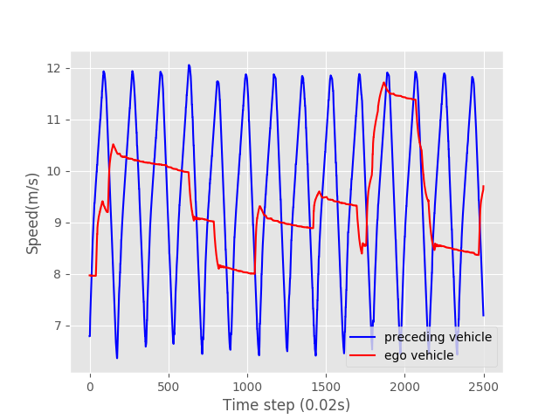
Test The trained acc agent
A Learning based Adaptive Cruise and Lane Control System
Action distribution
Speed variance
YouTuBe Link:
https://youtu.be/RcjZSAFbHV0

Slide 17
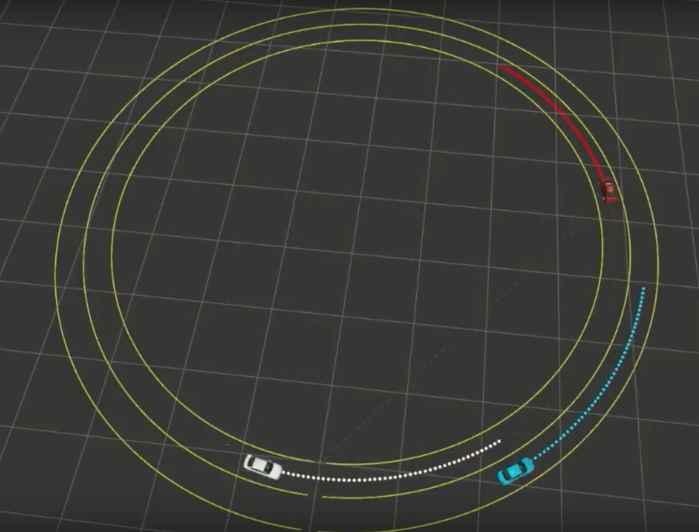
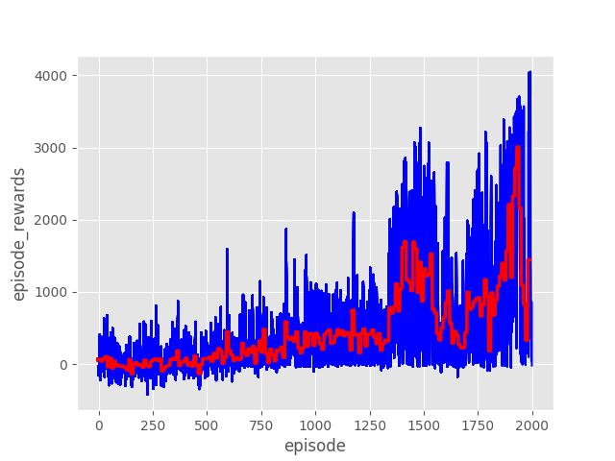
Train an ACC & LC agent
A Learning based Adaptive Cruise and Lane Control System
A Two-lane Highway Environment
Reward history

Slide 18
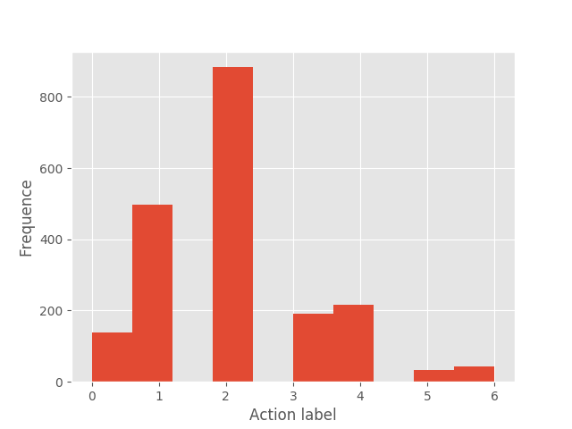
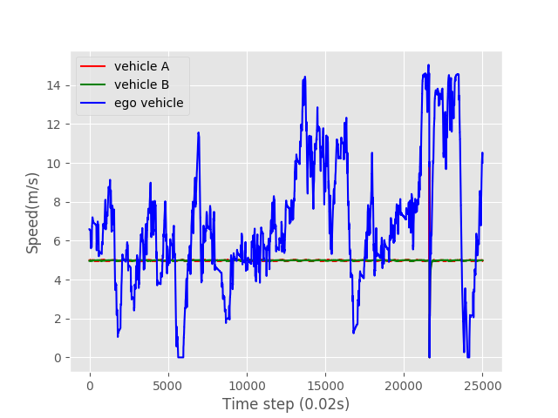
Test The trained acc & LC agent
A Learning based Adaptive Cruise and Lane Control System
Action distribution
Speed variance
YouTuBe Link:
https://youtu.be/nEqEXBDs2Co

Slide 19
Future Work
A Learning based Adaptive Cruise and Lane Control System
Tuned Reward Functions
Incorporate other RL techniques
asynchronous RL
double Q-learning
prioritized experience replay
Asynchronous Actor-Critic Agents (A3C)

Slide 20
Thank you!

